Slide 1
CAR MART MANAGEMENT PROJECT
SUBMITTED BY:
CHANPREET KAUR
D3-IT
1144683

Slide 2
Inroduction To Company

Slide 3
OIT
ONE IFONET TECHNOLOGIES

Slide 4
Objectives Of The Project

Slide 5
The project mainly addresses the planning , designing and execution of the interior and exterior of bussiness
work.
This project has been developed in java language .In this project efforts have been made to help the owner in dealing with customers and providing services and maintaining all relevant data with respect to services, customers and all employees.
This software will help to simplify the job of maintaining accounts with easy retreivability of data incoming clients.
This software developed with the help of cater the employment need of the company with minimum employment with immediate access to any data required at any time by the company or any outside agency.

Slide 6
Hardware And Software Specification
HARDWARE REQUIREMENTS
RAM
Processor
Floppy Disc
SOFTWARE REQUIREMENTS
NETBEANS IDE 7.3
MYSQL
JDK
Operating system : windows 8

Slide 7
Working Of The Project

Slide 8
The project consists of the following modules:
Login Module
Dealer Module
Employee Module
Customer Module
Feedback Module

Slide 9
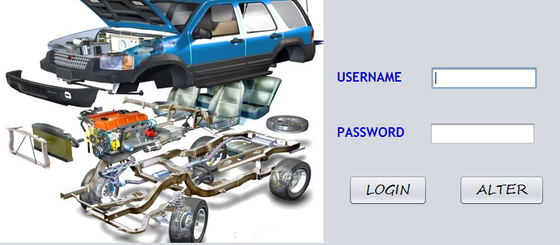
FILL THE LOGIN FORM WITH REGISTERED USERNAME AND PASSWORD
EVEN THE USER CAN CHANGE THE USERNAME AND PASSWORD..

Slide 10
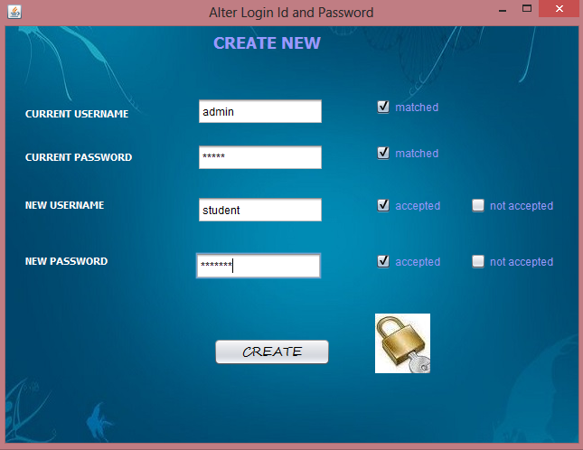
The New Username And Password Are Created..
MATCHING THE OLD USERNAME AND PASSWORD

Slide 11
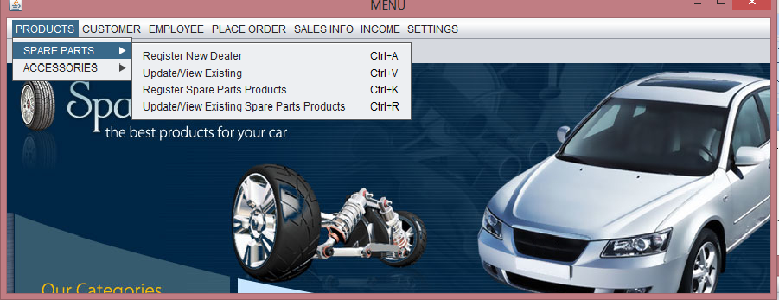
IT ALLOWS THE USER TO INTERACT WITH IMPORTANT APPLICATION AREAS
Logging In Yields Homepage………..

Slide 12
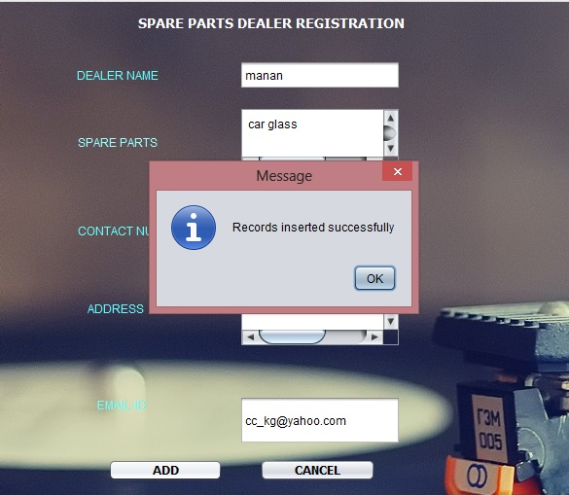
Registering Spare Parts And Accessories Dealers…

Slide 13
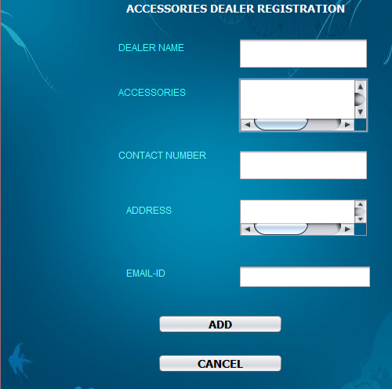
Accessories Dealer

Slide 14
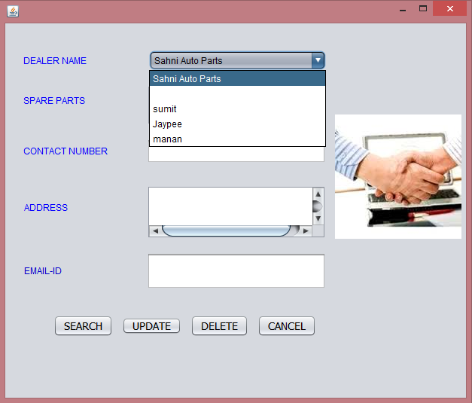
Viewing/updating & deleting registered dealers
FROM THE DROP DOWN REGISTERED DEALERS ARE SELECTED

Slide 15
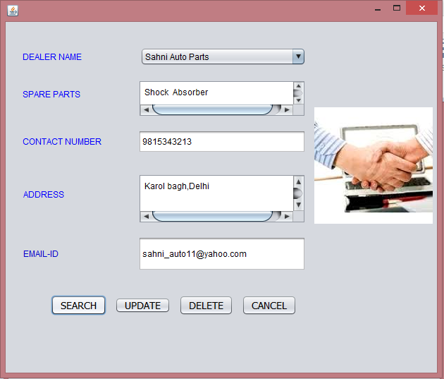
Simlarly details of the accessories dealer can be viewed/updated or deleted
USER CAN VIEW DETAILS OF SELECTED DEALER
ALLOWS TO UPDATE REGISTERED DETAILS

Slide 16
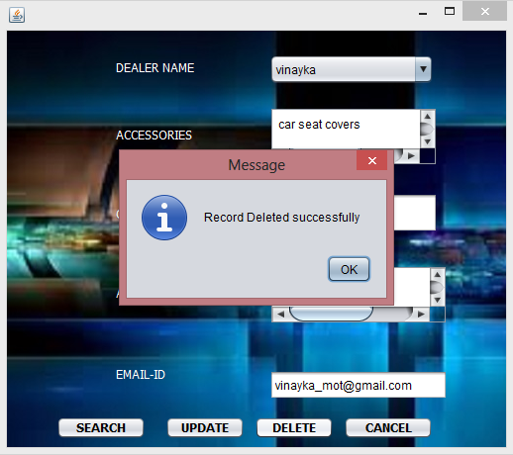
User Can Easily Delete The Records….

Slide 17
IN THE SAME MANNER ALL THE PRODUCTS ARE REGISTERED AND UPDATED

Slide 18
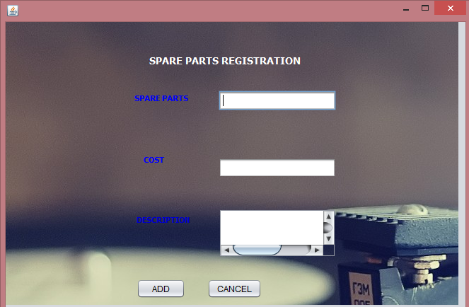
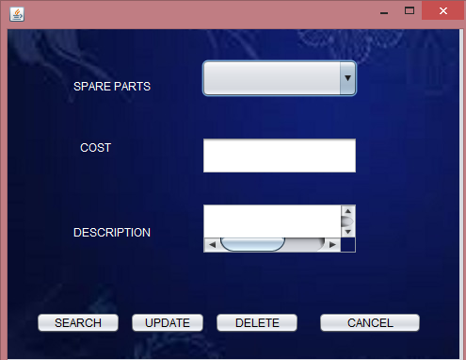

Slide 19
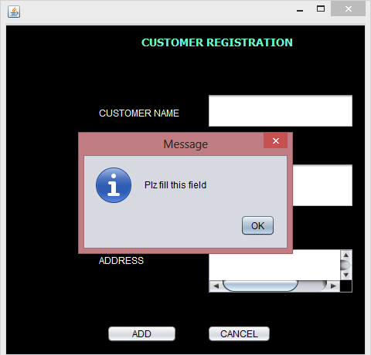
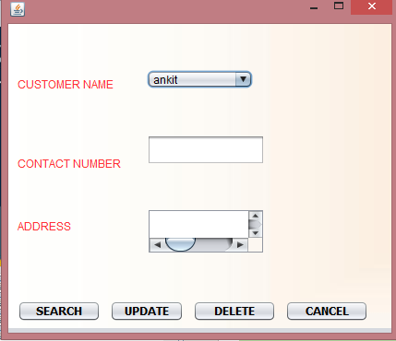
Customer registration and updation
GENERATING ALERT MESSAGE FOR EMPTY FIELDS
CUSTOMER DETAILS CAN BE SEARCHED ,UPDATED AND DELETED

Slide 20
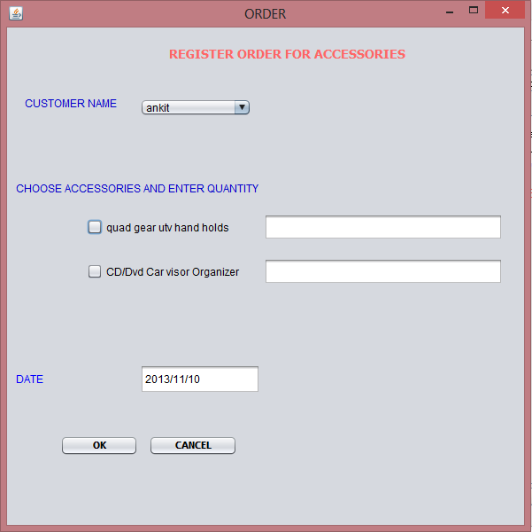
Registering customers order
SEECTING THE REGISTERED CUSTOMER
CHECK BOXES ARE DYNAMICALLY GENEARTED FOR THE REGISTERD ACCESSORIES
USER CAN EASILY REGISTER THE ORDER BY SELECTING TH EREQUIRED PRODUCT
THE QTY OF THE REQUIRED PRODUCT IS ENTERED

Slide 21
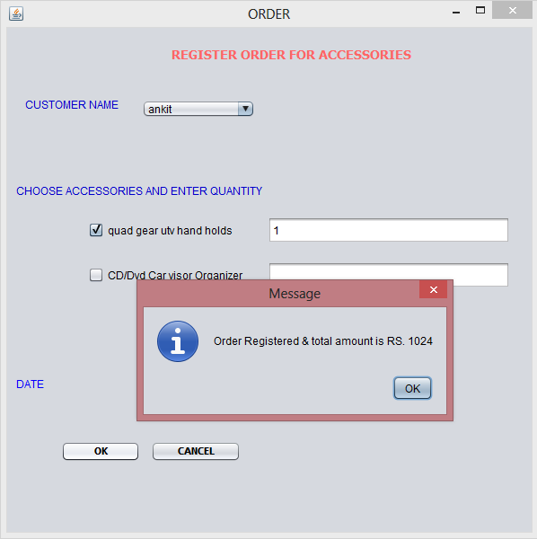
PRINTING BILL
ON THE CLICKING THE ORDER GETS REGISTERED AND THE TOTAL AMOUNT IS GENERATED

Slide 22
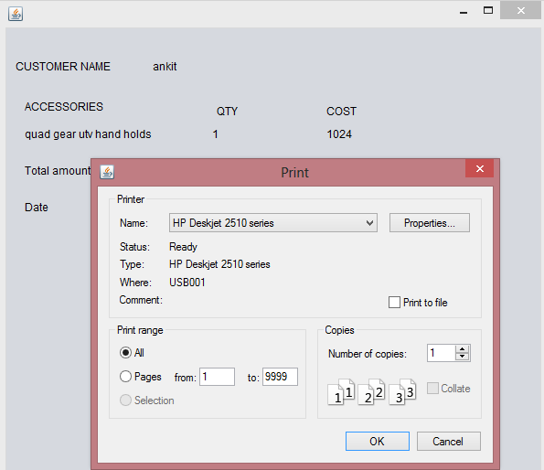
Printing the bill

Slide 23
SIMILARLY THE ORDER FOR THE SPARE PARTS CAN BE REGISTERED….

Slide 24
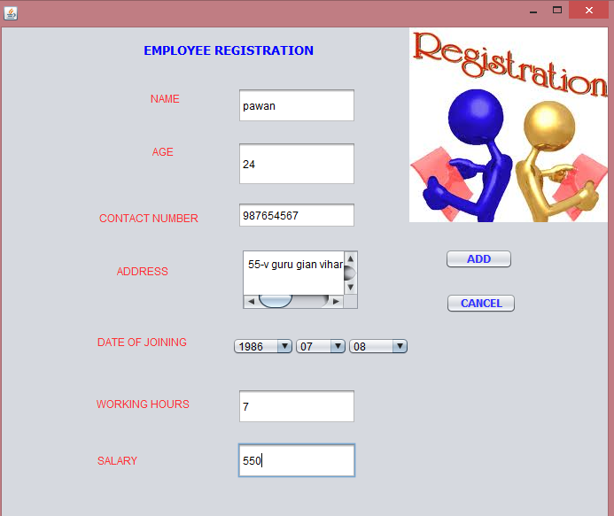
Fill The Registeration to register all employees..
GET REGISTERED

Slide 25
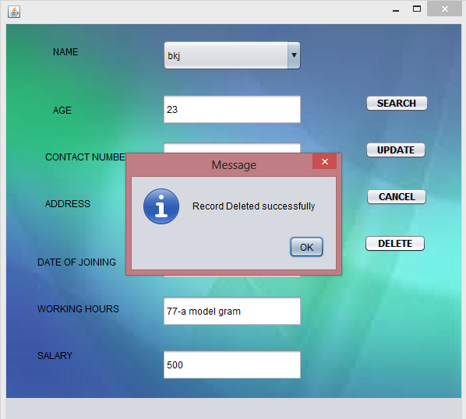
Edit Employee Details..

Slide 26
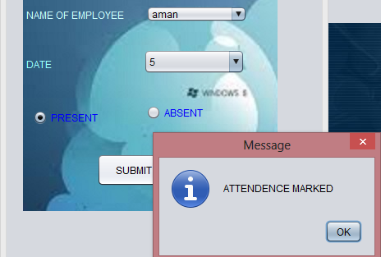
Mark Employee attendence
SELECT DATE AND NAME OF THE EMPLOYEE..

Slide 27
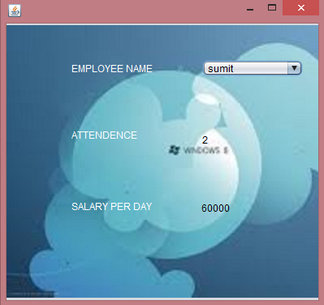
Checking The Attendence Of The Employee..
ON THE SELECTION OF THE EMPLOYEE WE CAN CHECK THE TOTAL ATTENDENCE OF THE EMPLOYEE

Slide 28
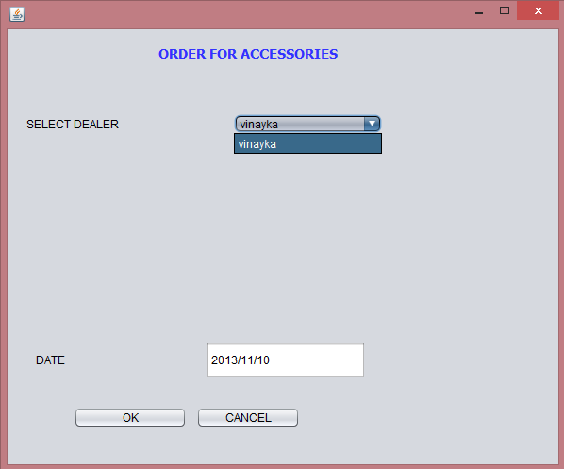
Placing Order To Dealers
SELECT THE DESIRED DEALER

Slide 29
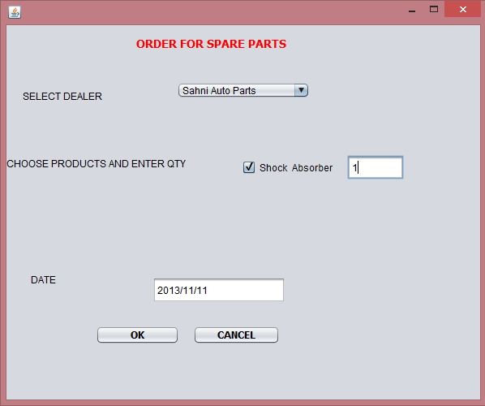
Click Ok To Place Order
PRODUCTS APPEAR ACCORDING TO THE DEALERS

Slide 30
VIEW DAILY SALES REPORT
FOR SPARE PARTS AND ACCESSORIES

Slide 31
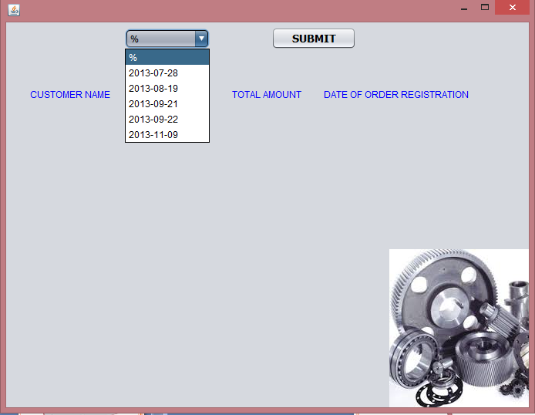
Info for accessories
SELECT DATE

Slide 32
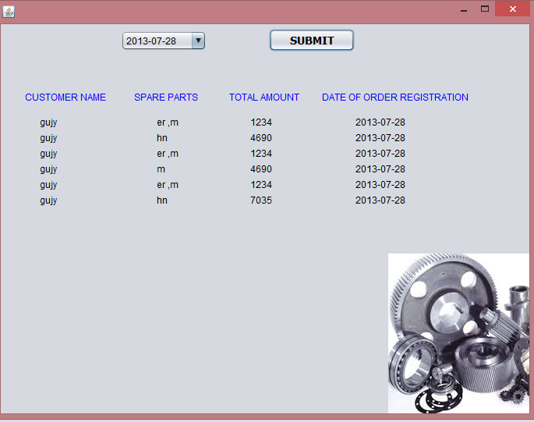
VIEW SALES

Slide 33
Simlarly sales reports for spare parts can be viewed….

Slide 34
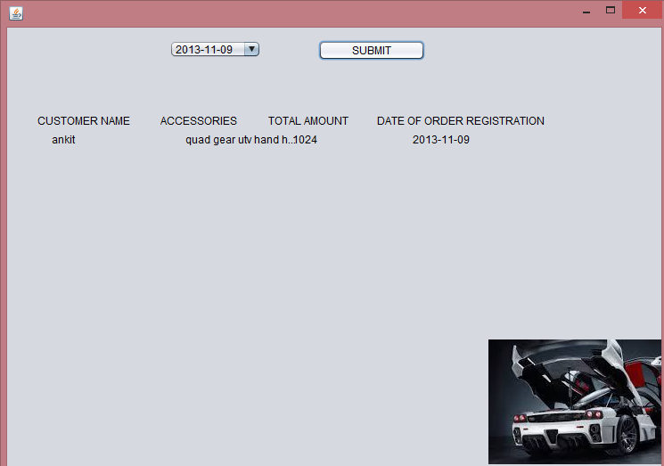
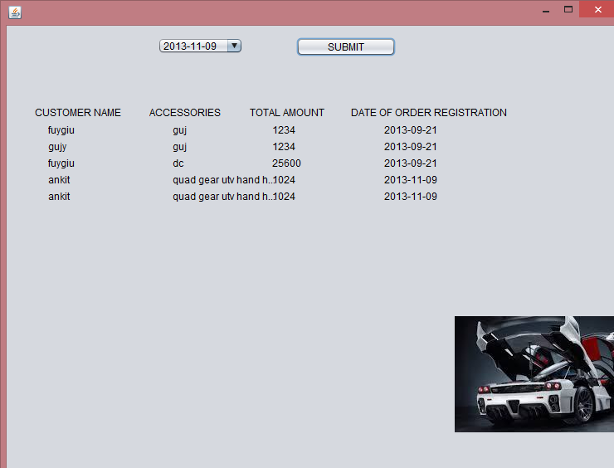

Slide 35
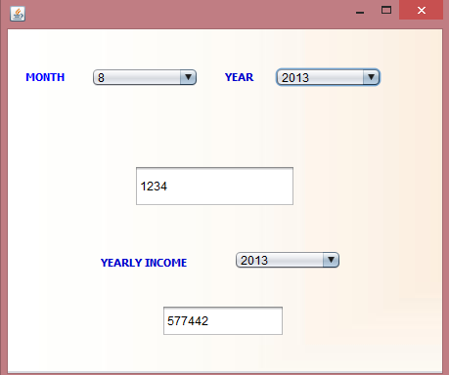
VIEW MONTHLY AND ANNUAL SALARY FOR ACCESSORIES AND SPARE PARTS..
SELECT MONTH AND YEAR
ACCESSORIES
NEXT

Slide 36
GET THE MONTHLY INCOME
CHECK THE YEARLY INCOME
NEXT

Slide 37
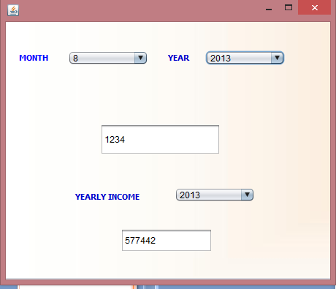
For Spare Parts
NEXT

Slide 38
THANK YOU..

